Slide 1
Introduction to Data Mining (COMP 4331)
Tutorial 9 Part I: Pretrained Model (using PyTorch)
Runsheng YU
ryuah@connect.ust.hk
HKUST
2021 Nov. 19
Notebook on Google Colab
https://colab.research.google.com/drive/1dgLai_j2ilCfkQQX0eXcbgND5Z2Cazi5?usp=sharing

Slide 2
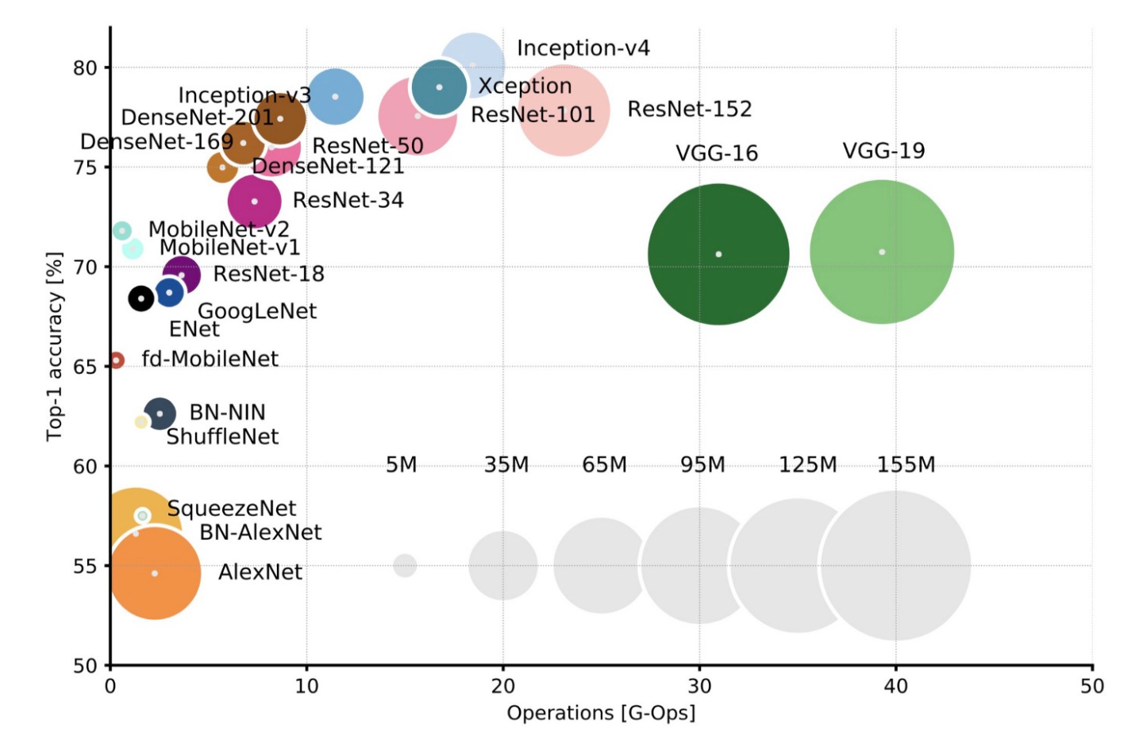

Millions of parameters and samples
Millions of parameters
14 million images
Computation burden
Image from: https://towardsdatascience.com/neural-network-architectures-156e5bad51ba

Slide 3
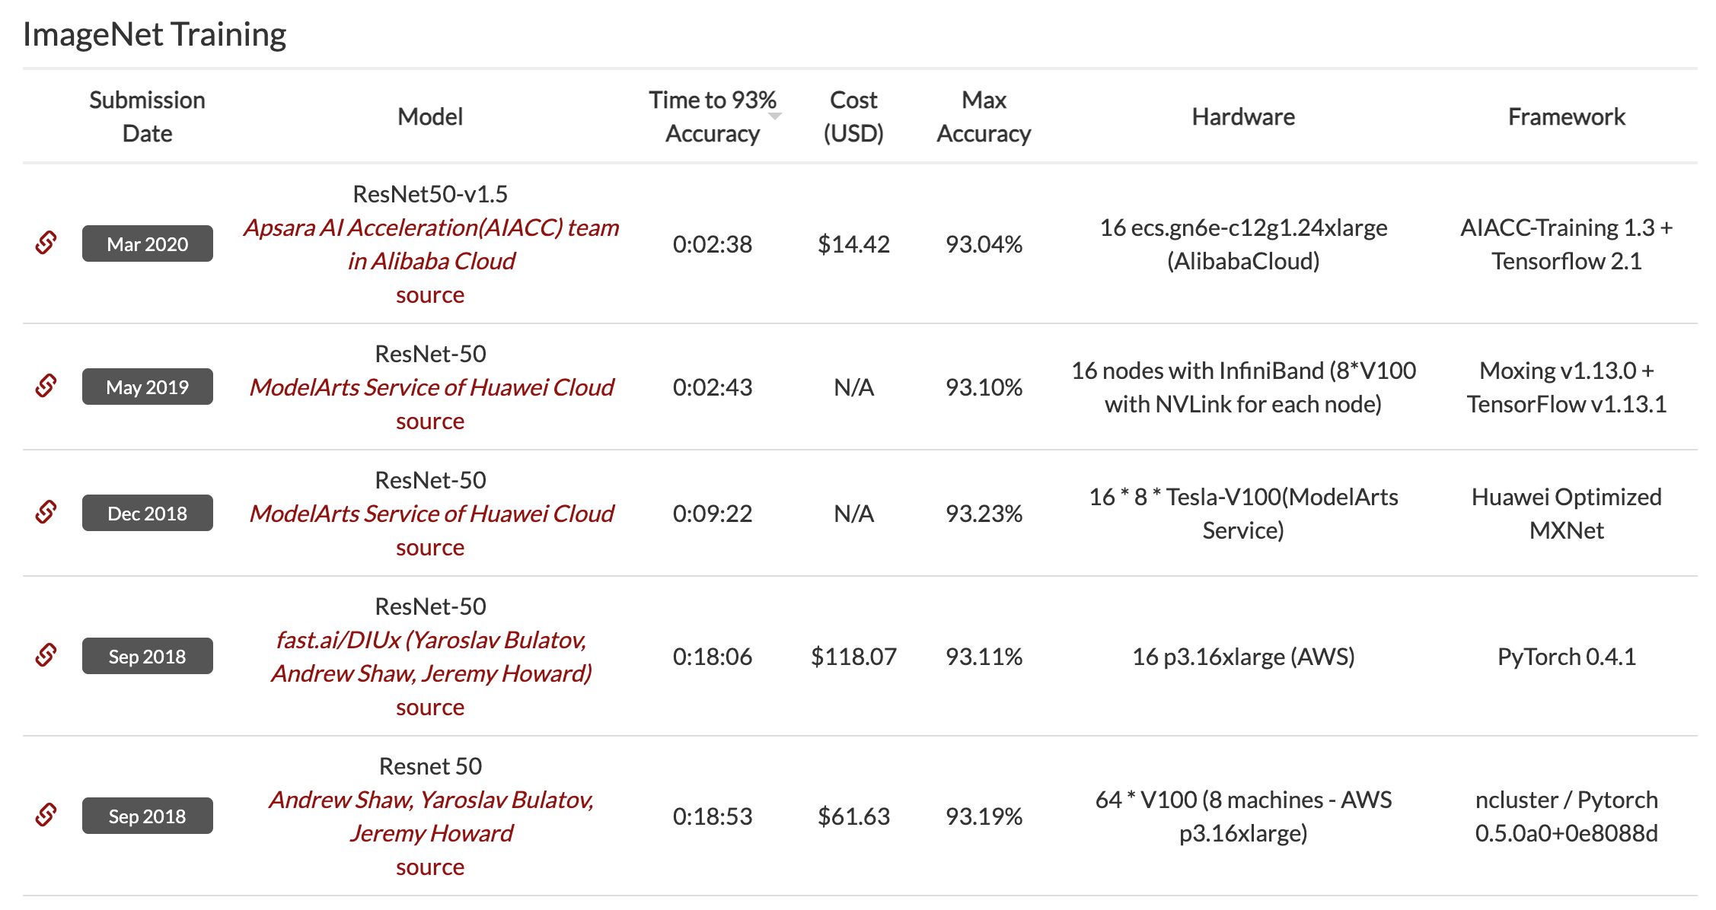
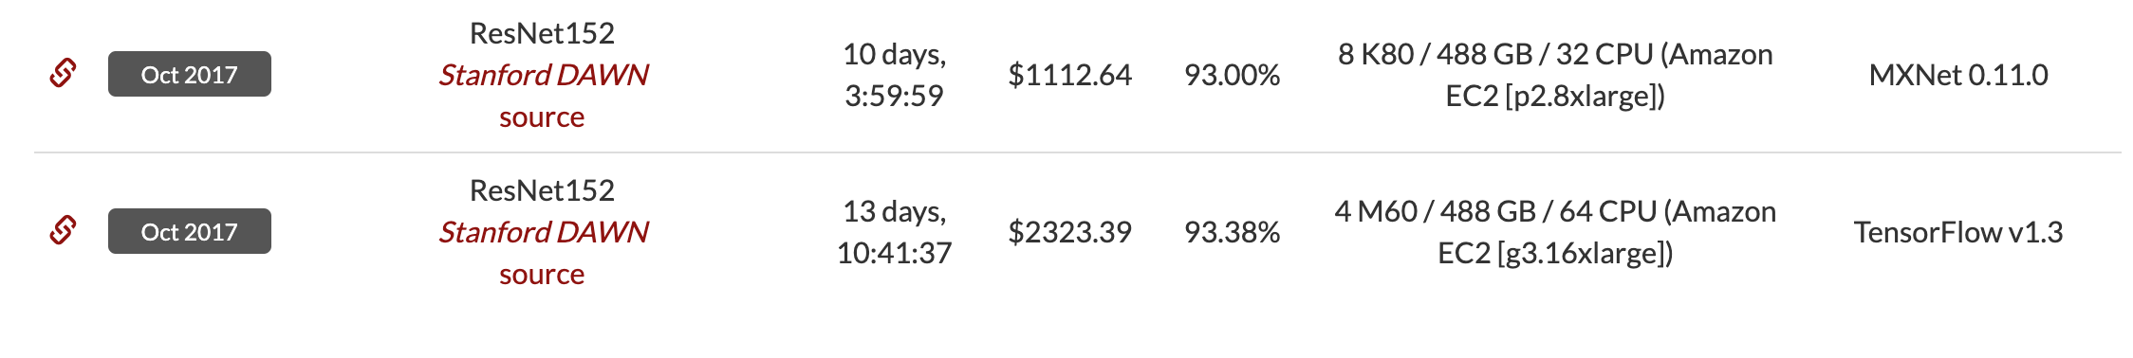
Training a large model on massive data is expensive and time-consuming
https://dawn.cs.stanford.edu/benchmark/ImageNet/train.html

Slide 4
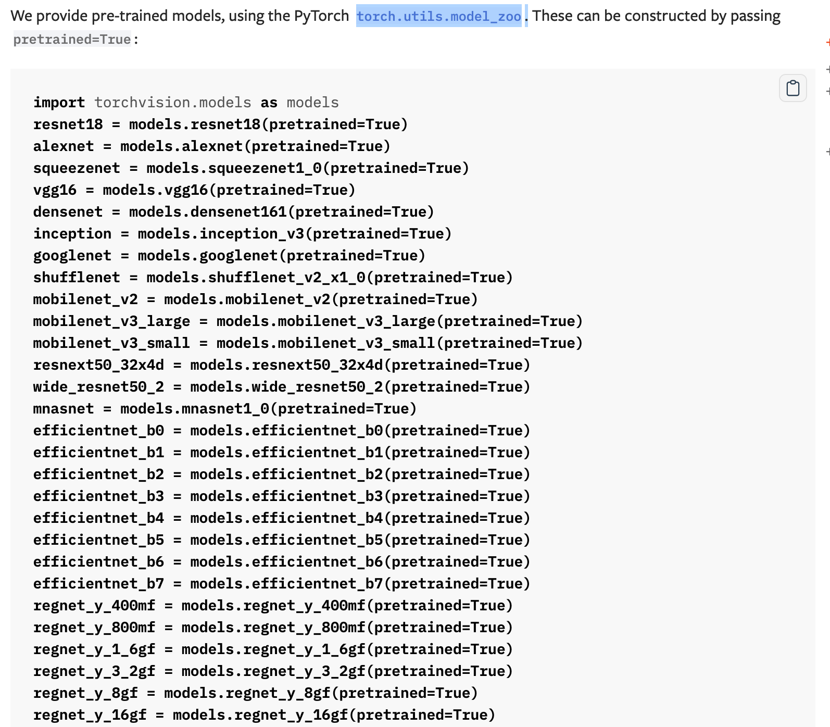
A Possible solution: Use pretrained models

Slide 5
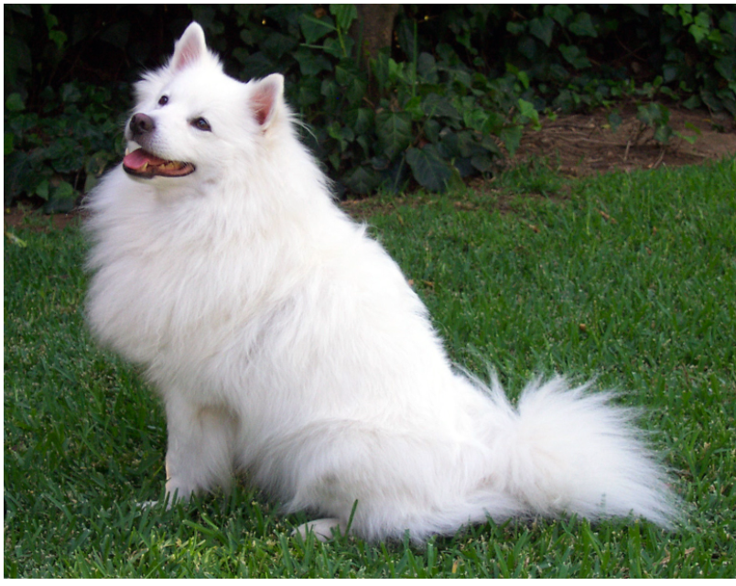
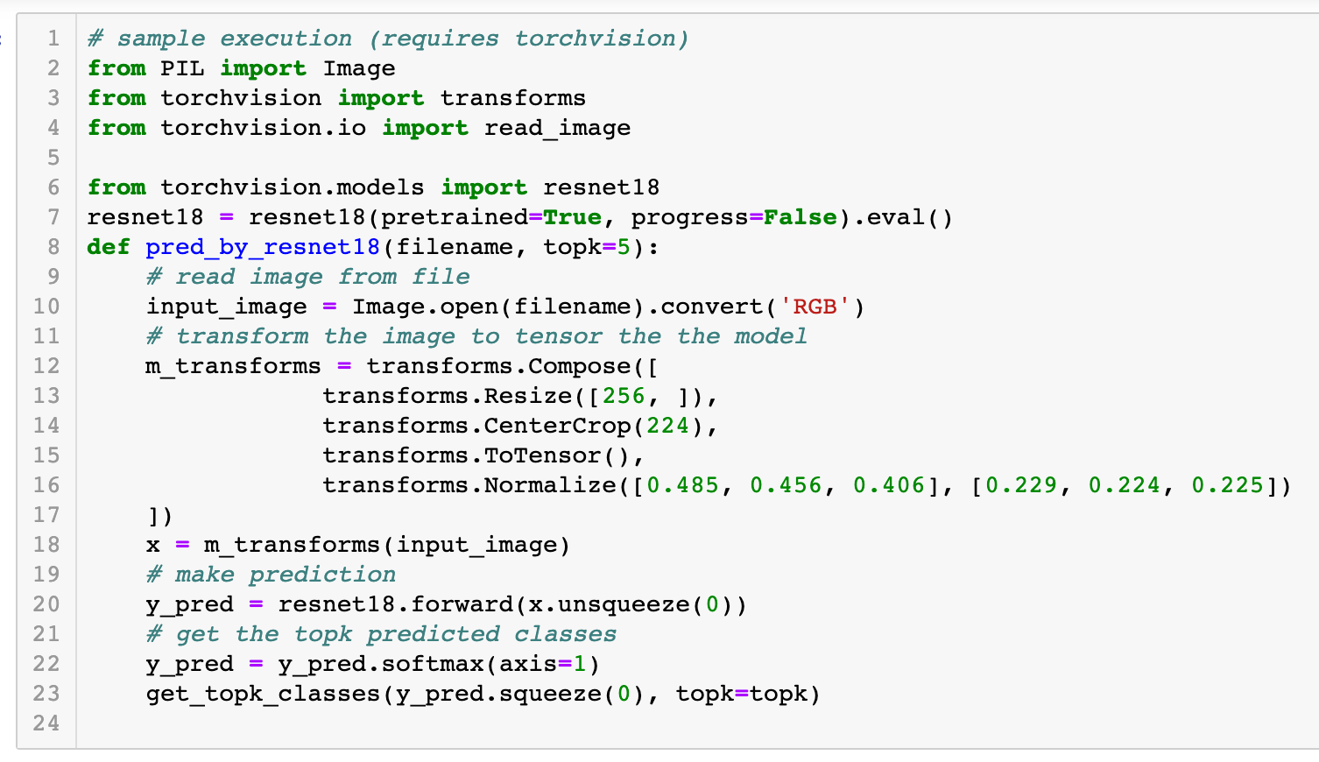
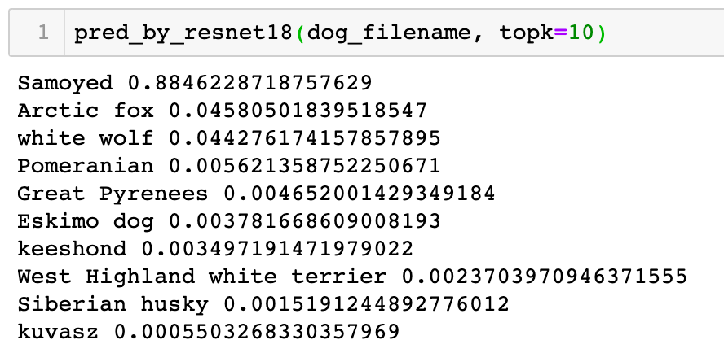
Example
Use a ResNet-18 model pretrained on ImageNet

Slide 6
Introduction to Data Mining (COMP 4331)
Tutorial 9 Part II: Clustering

Slide 7
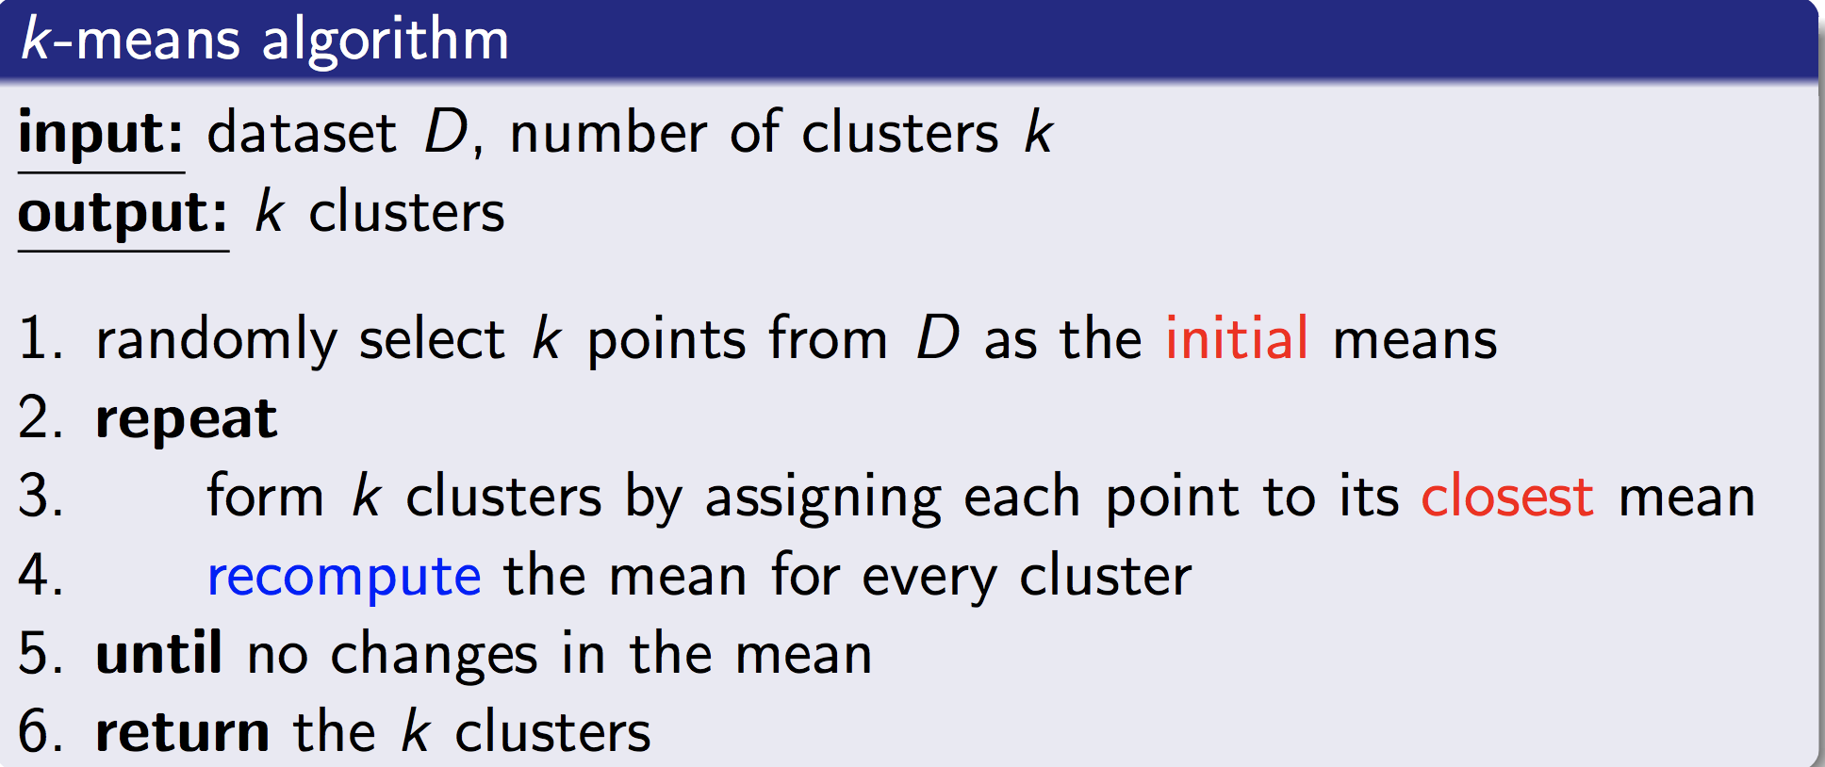
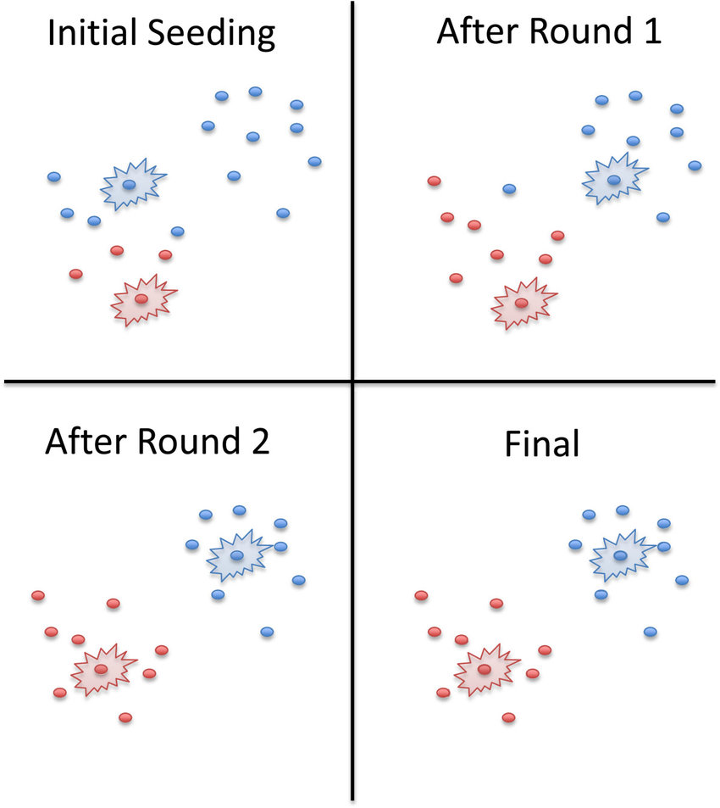
K-means:
Image from: https://www.researchgate.net/figure/K-means-clustering-algorithm-An-example-2-cluster-run-is-shown-with-the-clusters_fig3_268880805

Slide 8
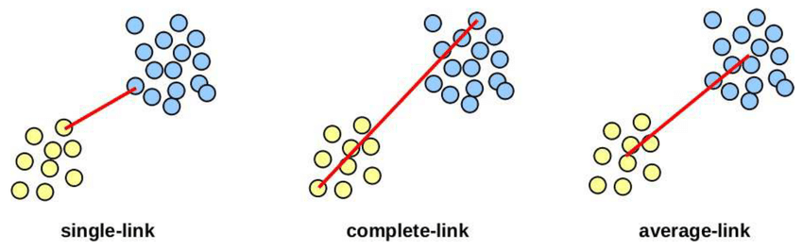
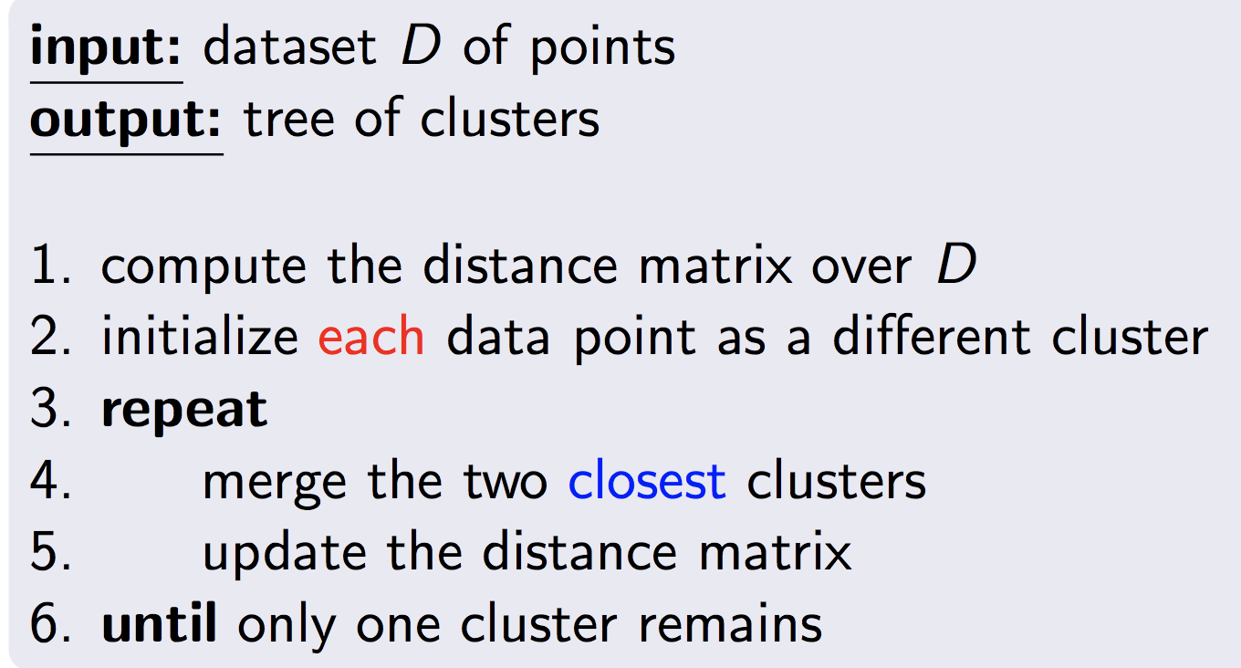
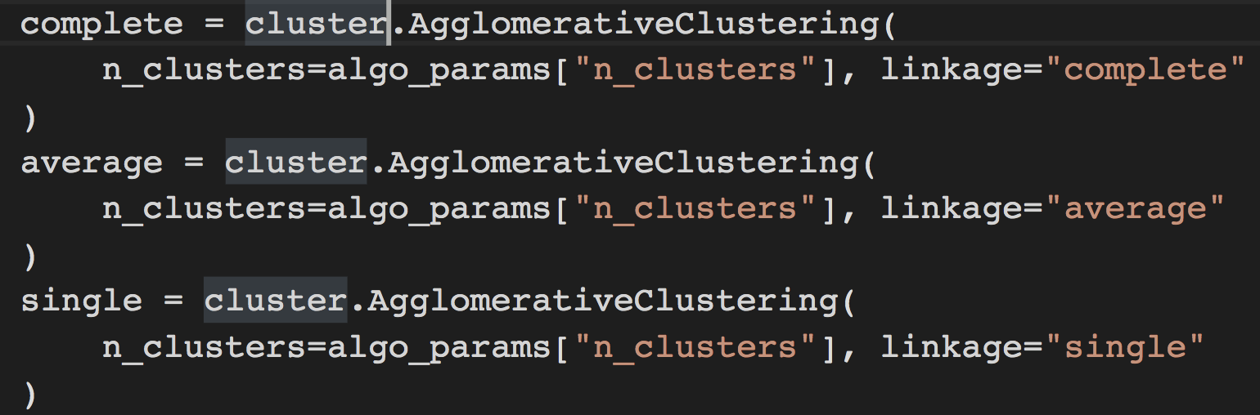
Hierarchical Clustering
Image from: https://www.researchgate.net/figure/schematic-representation-of-the-linkage-methods-single-link-complete-link-and_fig5_333845151

Slide 9
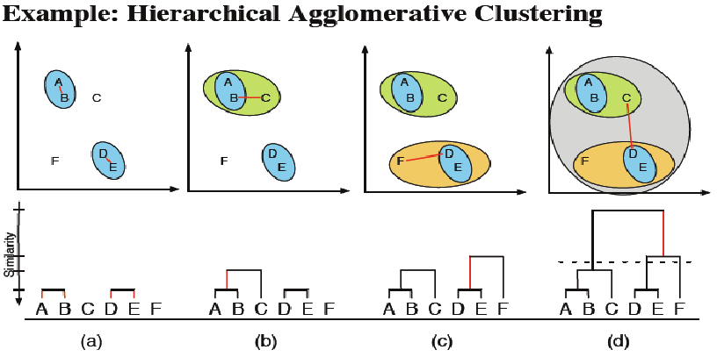
Hierarchical Clustering
Image from: https://github.com/rickiepark/introduction_to_ml_with_python/blob/master/03-unsupervised-learning.ipynb

Slide 10
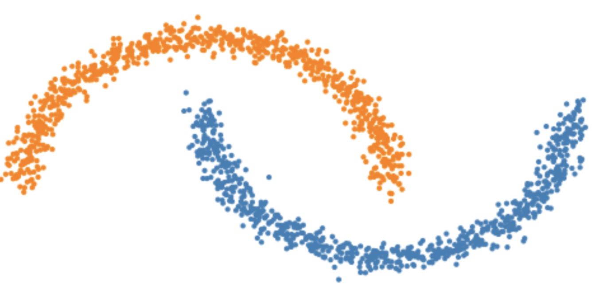
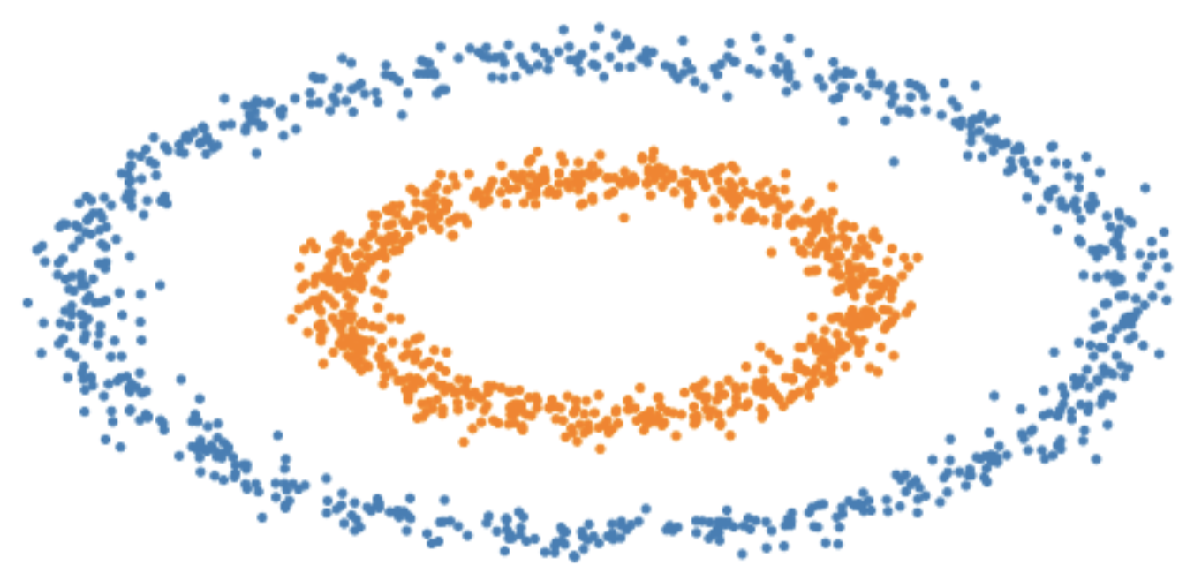
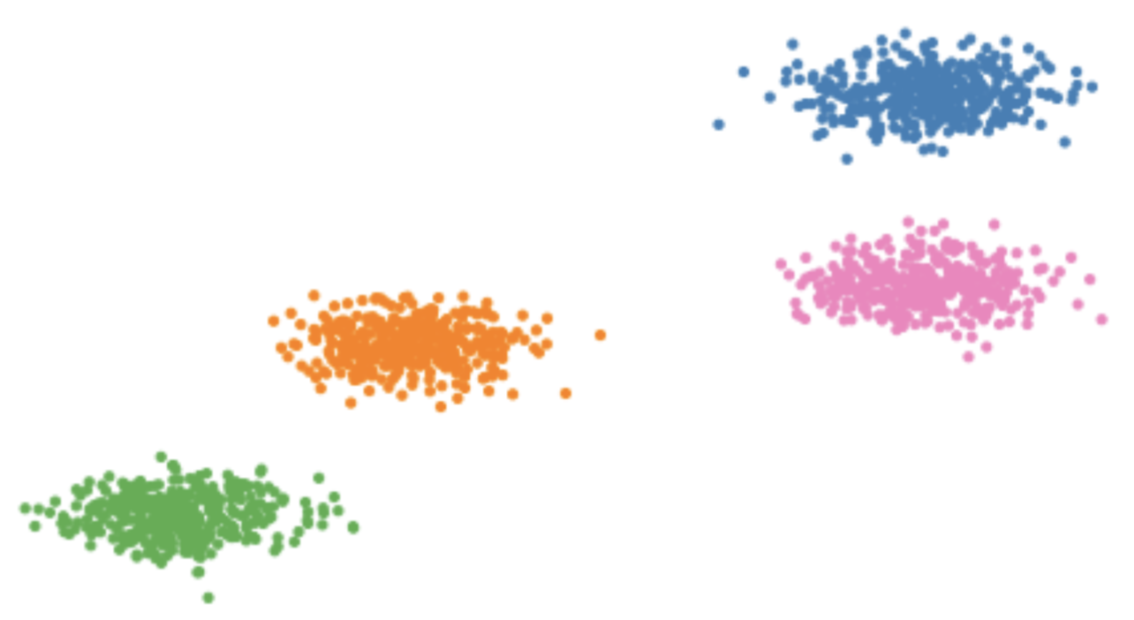
Toy examples:
Moon Circles Blobs

Slide 11
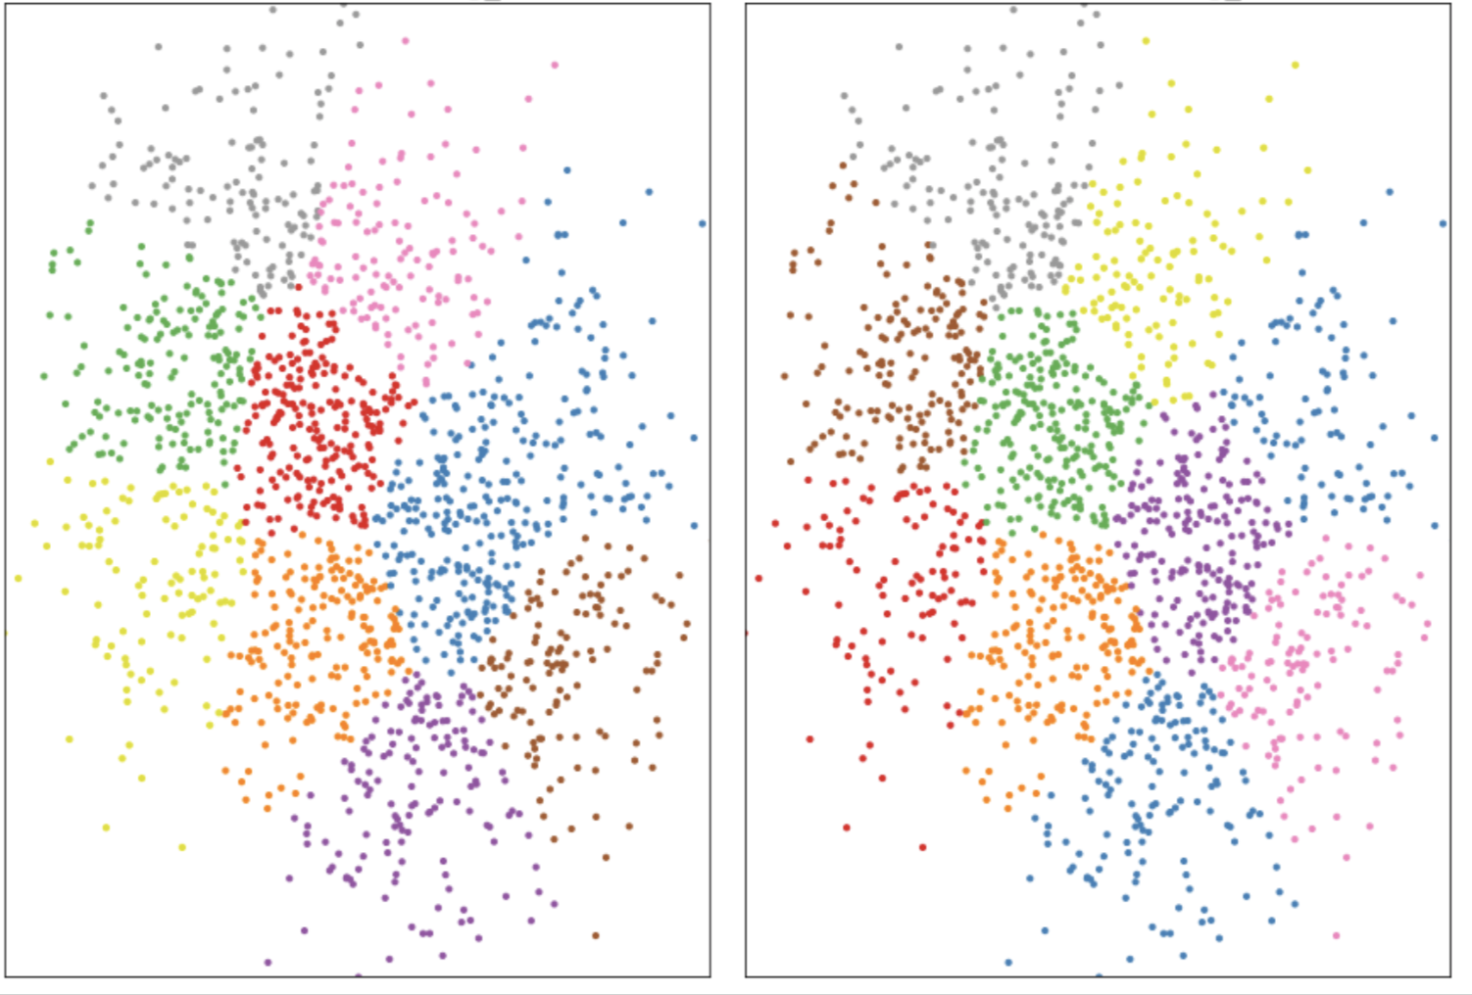
Local Minimum:
Kmeans seed 1 Kmeans seed 2

Slide 12
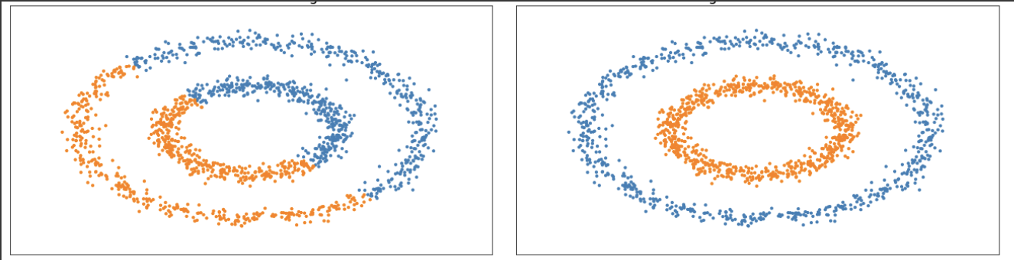
Implicit Assumption on Cluster Shape:
Kmeans Single-Link Distance
can get wrong results when clusters have other shapes

Slide 13
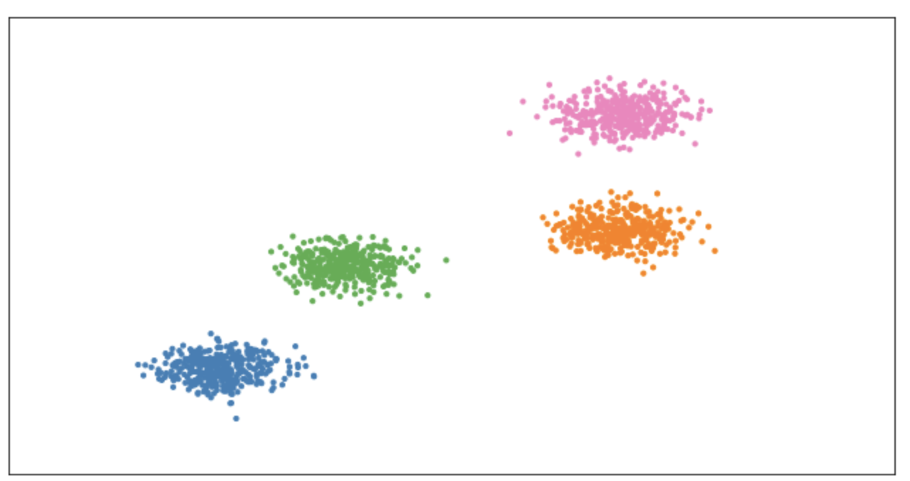
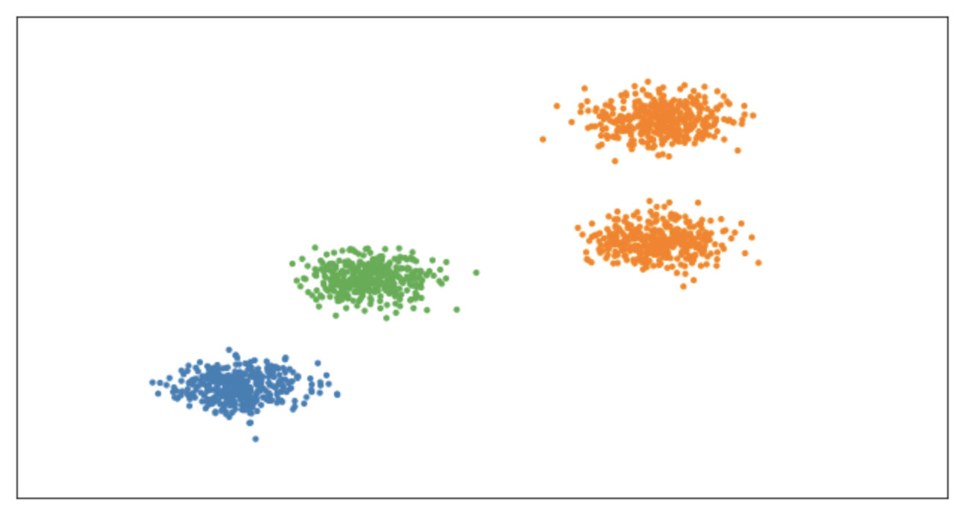
Number of Clusters
Kmeans 4 Clusters Kmeans 3 Clusters

Slide 14
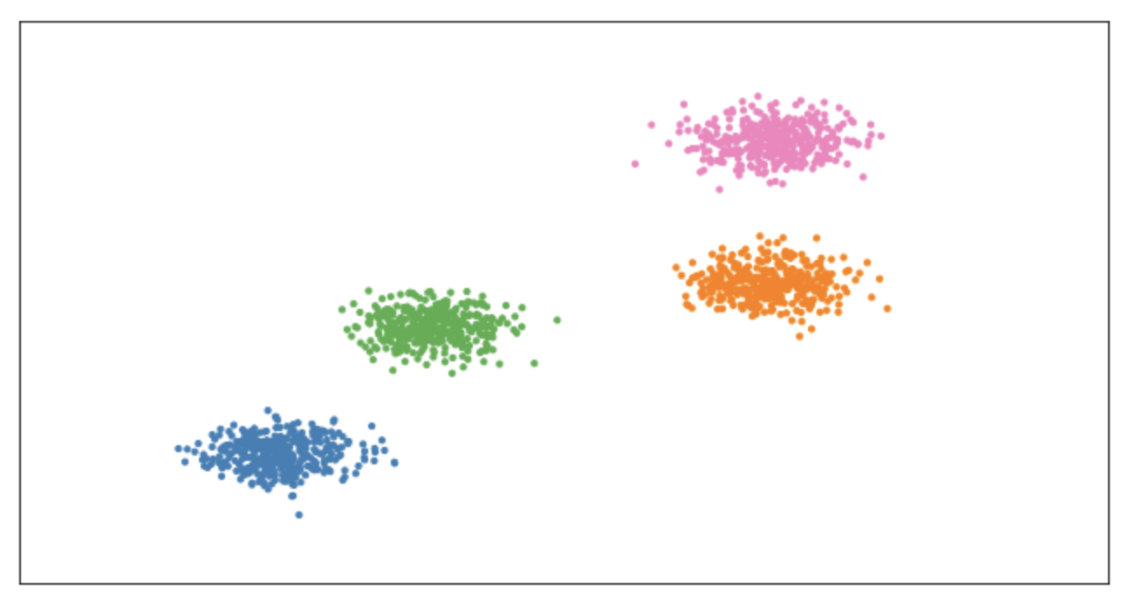
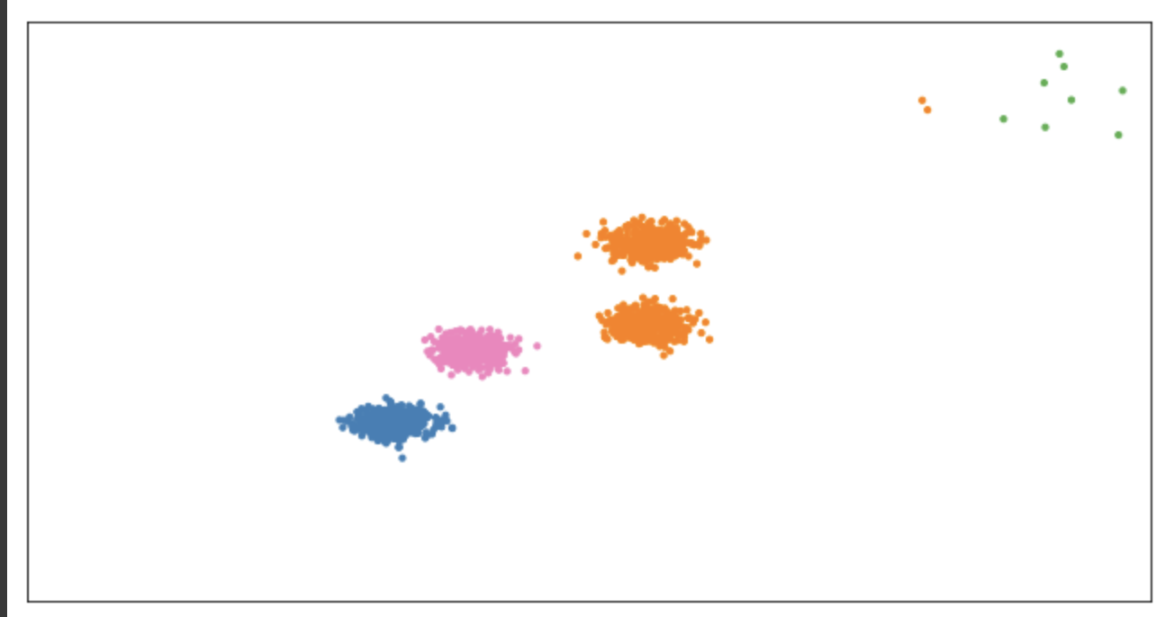
Outliers
Kmeans w/o outliers Kmeans with outliers

Slide 15
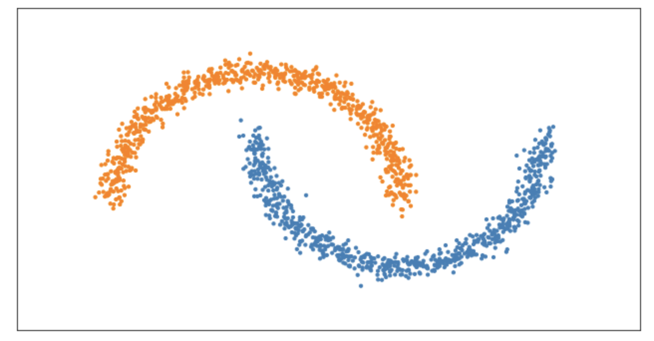
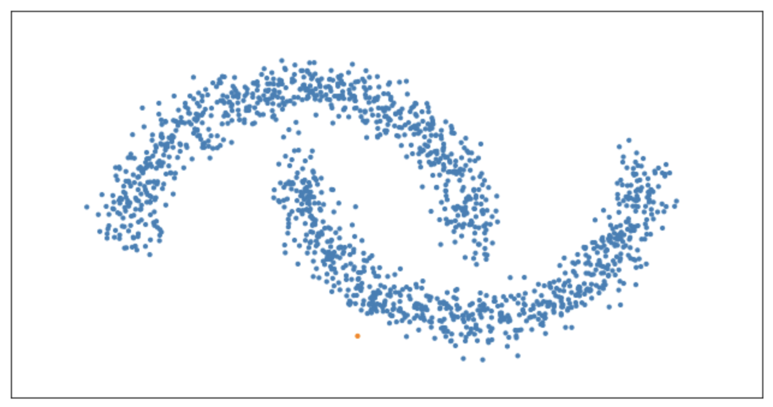
Noise data
Single-Link Distance Single-Link Distance with noise

Slide 16
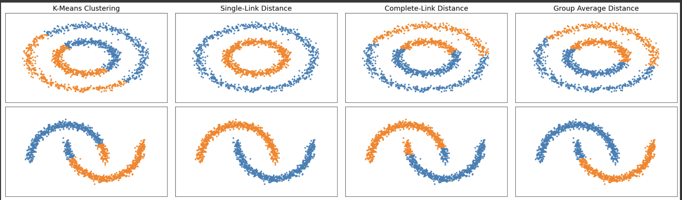
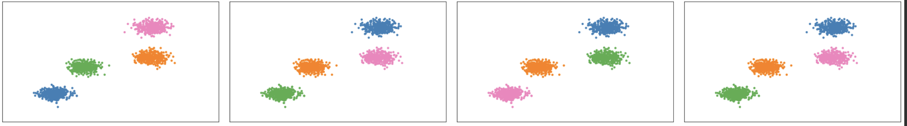
More Results

Slide 17
Introduction to Data Mining (COMP 4331)
Tutorial 9 Part III: Remarks on Assignment 2

Slide 18
Q1 (a)
Learn a decision tree using the information gain, with min_samples_split (the minimum number of samples required to split an internal node) equals 2. Show
(i) the tree obtained;
(ii) training accuracy;
(iii) testing accuracy
Steps:
Splitting the datasets, encoding, fit the model, predict the results, Draw the trees.
-2 If the dataset is wrongly spitted.
Both one hot encoding and the ordinal encoding are acceptable.

Slide 19
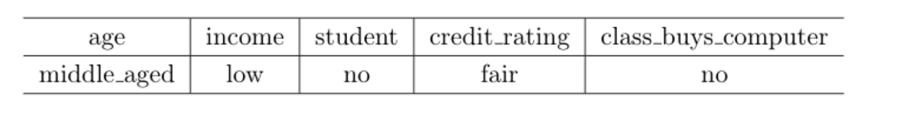
Q1 (b)
Consider adding the following noisy sample to the training set.
Repeat part (a) with the expanded training set. Compare and contrast with the solution you obtained
in part (a).
Steps:
1. Create and encode the noise example.
2. Follow the same steps in Q1 (a).
3. Adding noise example causes overfitting problem.
Other answers are also acceptable.
-2 if you did not provide an answer or the answer is wrong.

Slide 20
Q1 (c)
Repeat part (a) by using the gini index.
Follow the steps 1-3 in Q1 (a).

Slide 21
Q2 (a)
Similar to Q1, part (a), learn a naive Bayes classifier on the original data set. Show
(i) training accuracy; and
(ii) testing accuracy.
Steps :
1 Preprocess the dataset:
2 Train a naïve Bayes model.
3 Show the results.
-2 if you set the wrong Laplace correction value.

Slide 22
Q2 (b)
Similar to Q1, part (b), learn a naive Bayes classifier on the noisy data set. Show the
(i) training accuracy; and
(ii) testing accuracy
Add the noise example into the training set.
Follow the steps in Q2 (a).

Slide 23
Thanks!

